Slide 1
Lesson 9
Handling Exceptions

Slide 2
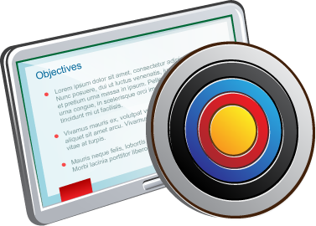
Objective
After completing this lesson, you should be able to do the following:
  Define PL/SQL exceptions
  Recognize unhandled exceptions
  List and use different types of PL/SQL exception handlers
  Trap unanticipated errors
  Describe the effect of exception propagation in nested blocks
  Customize PL/SQL exception messages

Slide 3

Agenda
  Understanding PL/SQL exceptions
  Trapping exceptions

Slide 4

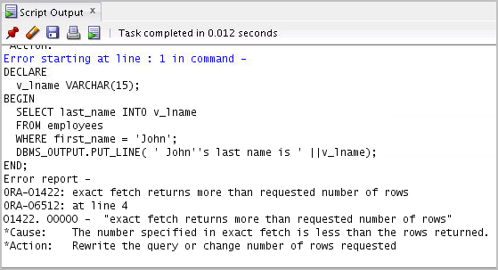
What Is an Exception?
DECLARE
v_lname VARCHAR2(15);
BEGIN
SELECT last_name INTO v_lname
FROM employees
WHERE first_name='John';
DBMS_OUTPUT.PUT_LINE ('John''s last name is :' ||v_lname);
END;

Slide 5


Handling an Exception: Example
DECLARE
v_lname VARCHAR2(15);
BEGIN
SELECT last_name INTO v_lname
FROM employees
WHERE first_name='John';
DBMS_OUTPUT.PUT_LINE ('John''s last name is :' ||v_lname);
EXCEPTION
WHEN TOO_MANY_ROWS THEN
DBMS_OUTPUT.PUT_LINE (' Your select statement retrieved
multiple rows. Consider using a cursor.');
END;
/

Slide 6

Understanding Exceptions with PL/SQL
  An exception is a PL/SQL error that is raised during program execution.
  An exception can be raised:
    Implicitly by the Oracle Server
    Explicitly by the program
  An exception can be handled:
    By trapping it with a handler
    By propagating it to the calling environment

Slide 7


Handling Exceptions
Is
the exception
trapped?
Terminate Abruptly
NO
YES
Exception is raised
Propagate the exception
Execute statements in the EXCEPTION section
Terminate gracefully

Slide 8
Exception Types
  Internally defined
  Predefined
Implicitly raised
  User-defined
Explicitly raised

Slide 9
Agenda
  Understanding PL/SQL exceptions
  Trapping exceptions

Slide 10

Syntax to Trap Exceptions
EXCEPTION
WHEN exception1 [OR exception2 . . .] THEN
statement1;
statement2;
. . .
[WHEN exception3 [OR exception4 . . .] THEN
statement1;
statement2;
. . .]
[WHEN OTHERS THEN
statement1;
statement2;
. . .]

Slide 11

Guidelines for Trapping Exceptions
  The EXCEPTION keyword starts the exception-handling section.
  Several exception handlers are allowed.
  Only one handler is processed before leaving the block.
  WHEN OTHERS is the last clause.

Slide 12




Trapping Internally Predefined Exceptions
Declare
Associate
Reference
Declarative section
EXCEPTION section
Name the
exception.
Use PRAGMA EXCEPTION_INIT.
Handle the raised exception.

Slide 13




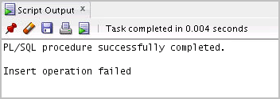
Internally Defined Exception Trapping: Example
To trap Oracle Server error 01400 (“cannot insert NULL”):
DECLARE
e_insert_excep EXCEPTION;
PRAGMA EXCEPTION_INIT(e_insert_excep, -01400);
BEGIN
INSERT INTO departments
(department_id, department_name) VALUES (280, NULL);
EXCEPTION
WHEN e_insert_excep THEN
DBMS_OUTPUT.PUT_LINE('INSERT OPERATION FAILED');
END;
/
1
2
3

Slide 14

Trapping Predefined Exceptions
  Reference the predefined name in the EXCEPTION block.
  Some sample predefined exceptions are:
    NO_DATA_FOUND
    TOO_MANY_ROWS
    INVALID_CURSOR
    ZERO_DIVIDE
    DUP_VAL_ON_INDEX
EXCEPTION
  WHEN NO_DATA_FOUND THEN
  statement1;
  ...
  WHEN TOO_MANY_ROWS THEN
  statement1;
  ...
  WHEN OTHERS THEN
  statement1;

Slide 15
Functions for Trapping Exceptions
  SQLCODE: Returns the numeric value for the error code
  SQLERRM: Returns the message associated with the error number

Slide 16

Functions for Trapping Exceptions
DECLARE
error_code NUMBER;
error_message VARCHAR2(255);
BEGIN
...
EXCEPTION
...
WHEN OTHERS THEN
ROLLBACK;
error_code := SQLCODE ;
error_message := SQLERRM ;
INSERT INTO errors (e_user, e_date, error_code,
error_message) VALUES(USER,SYSDATE,error_code,
error_message);
END;
/

Slide 17



Trapping User-Defined Exceptions
Declare
  Name the exception in the DECLARE section.
Raise
  Define the condition when the exception must be raised in executable section.
Reference
  Handle the exception.

Slide 18
RAISE Statement
  Stops normal execution of a PL/SQL block or subprogram, and transfers control to an exception handler
  Explicitly raises predefined exceptions or user-defined exceptions
  Syntax:
RAISE exception_name ;

Slide 19

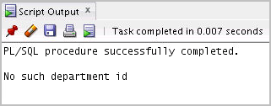
Trapping User-Defined Exceptions
DECLARE
v_deptno NUMBER := 500;
v_name VARCHAR2(20) := 'Testing';
e_invalid_department EXCEPTION;
BEGIN
UPDATE departments
SET department_name = v_name
WHERE department_id = v_deptno;
IF SQL%NOTFOUND THEN
RAISE e_invalid_department;
END IF;
COMMIT;
EXCEPTION
WHEN e_invalid_department THEN
DBMS_OUTPUT.PUT_LINE('No such department id.');
END;
/

Slide 20

Propagating Exceptions in a Sub-Block
DECLARE
. . .
e_no_rows exception;
e_integrity exception;
PRAGMA EXCEPTION_INIT (e_integrity, -2292);
BEGIN
FOR c_record IN emp_cursor LOOP
BEGIN
SELECT ...
UPDATE ...
IF SQL%NOTFOUND THEN
RAISE e_no_rows;
END IF;
END;
Sub-blocks can handle an exception or pass the exception to the enclosing block.
END LOOP;
EXCEPTION
WHEN e_integrity THEN ...
WHEN e_no_rows THEN ...
END;
/

Slide 21

The RAISE_APPLICATION_ERROR Procedure
Syntax:
2
raise_application_error (error_number,
message[, {TRUE | FALSE}]);
Value
  You can use this procedure to issue user-defined error messages from stored subprograms.
  You can report errors to your application and avoid returning unhandled exceptions
Unique key column
Unique key column
Unique key column
Unique key column

Slide 22
The RAISE_APPLICATION_ERROR Procedure
  Is used in two different places:
    Executable section
    Exception section
  Returns error conditions to the user in a manner that is consistent with other Oracle Server errors

Slide 23

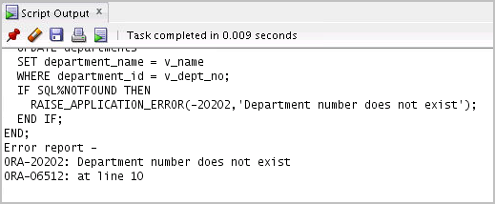
The RAISE_APPLICATION_ERROR Procedure
DECLARE
v_deptno NUMBER := 500;
v_name VARCHAR2(20) := 'Testing';
e_invalid_department EXCEPTION;
BEGIN
UPDATE departments
SET department_name = v_name
WHERE department_id = v_deptno;
IF SQL%NOTFOUND THEN
RAISE_APPLICATION_ERROR(-20202, 'Department number does not exist');
END IF;
END;

Slide 24

Quiz
You can trap any error by including a corresponding handler within the exception-handling section of the PL/SQL block.
  True
  False

Slide 25
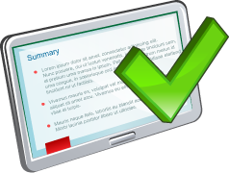
Summary
In this lesson, you should have learned how to:
  Define PL/SQL exceptions
  Add an EXCEPTION section to the PL/SQL block to deal with exceptions at run time
  Handle different types of exceptions:
    Internally defined exceptions
    Predefined exceptions
    User-defined exceptions
  Propagate exceptions in nested blocks and call applications

Slide 26


Practice 9: Overview
This practice covers the following topics:
  Creating and invoking user-defined exceptions
  Handling named Oracle Server exceptions

